Slide 1

DR-KANTreeNet for Diabetic Retinopathy Classification
CS566 Final Project
Yikai Chen
11/Dec/2025

Slide 2

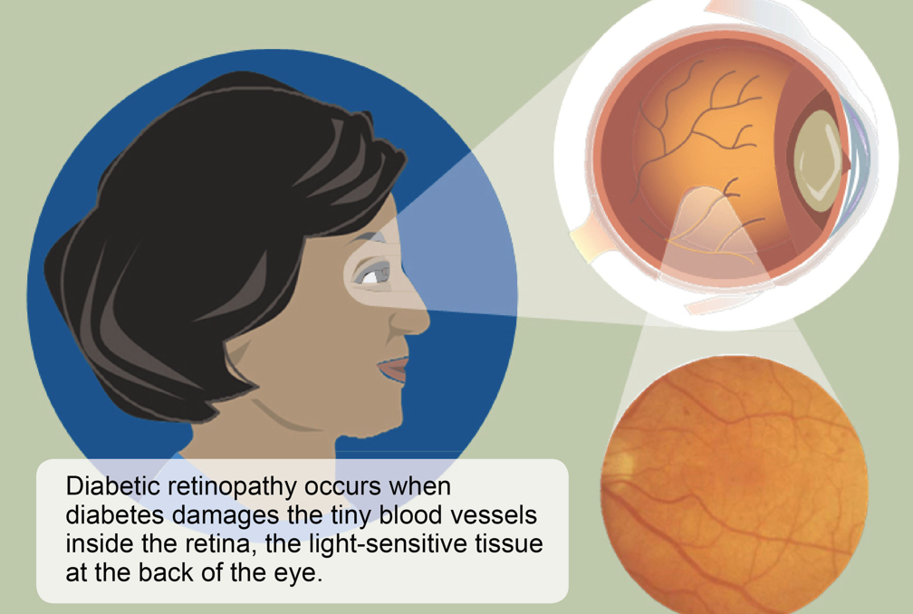
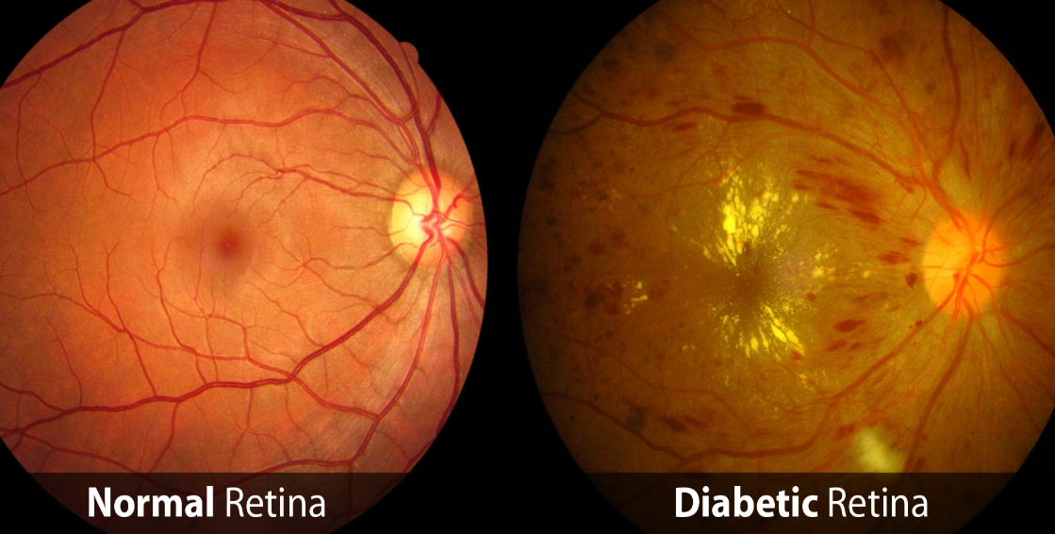
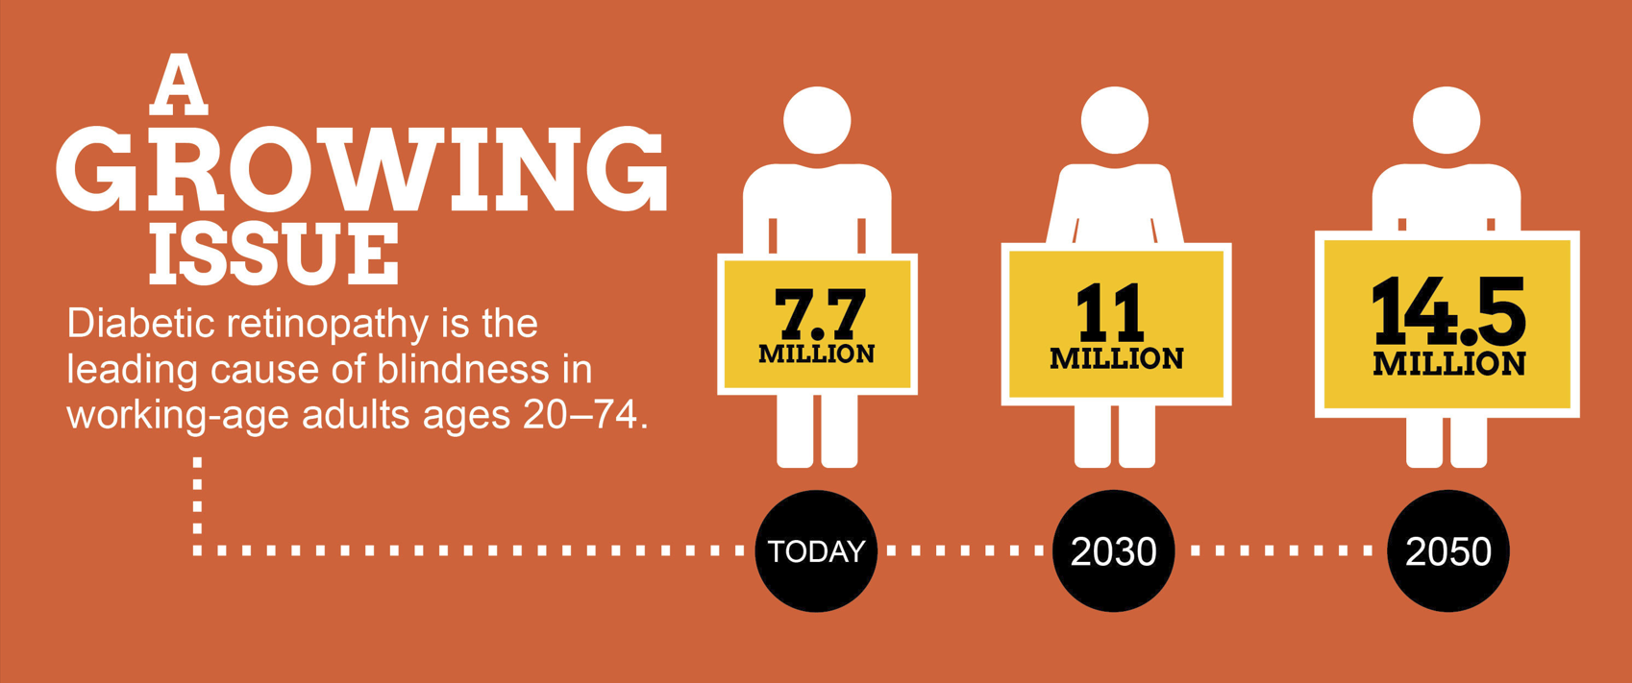
Motivation&Why important
What is diabetic retinopathy?
01
DR identified as a predominant complication of diabetes affecting millions globally.
Roughly one in three individuals with diabetes are impacted by DR, with this number on the rise.

Slide 3
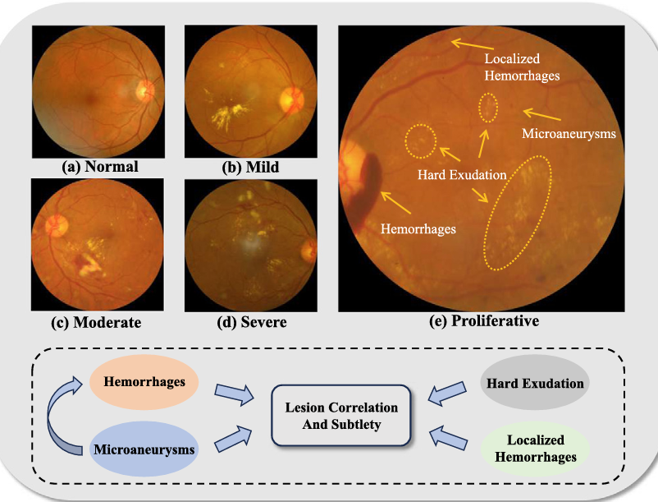
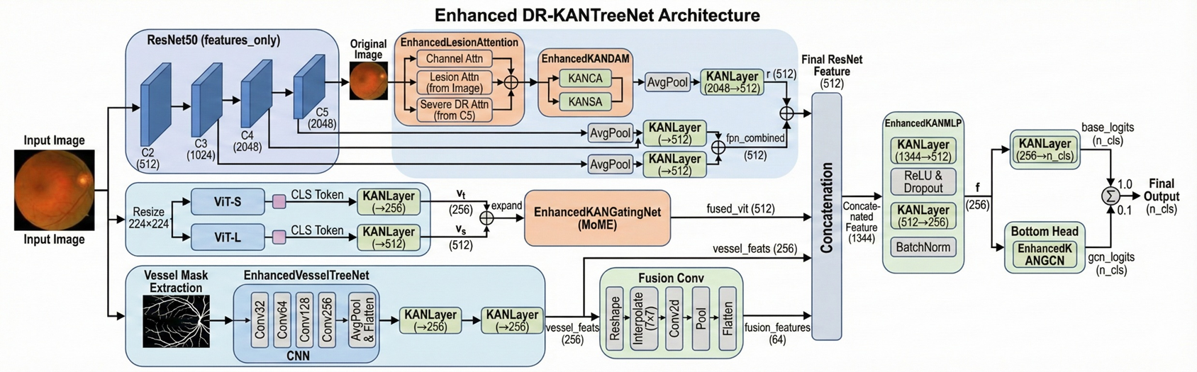
Approach
DR Scale
0: Normal
1: Mild, microaneurysms
2: Moderate, hard exudates
3: Severe, (Localized) Hemorrhages; 3 types of problems have arisen.
4: Proliferative, All

Slide 4
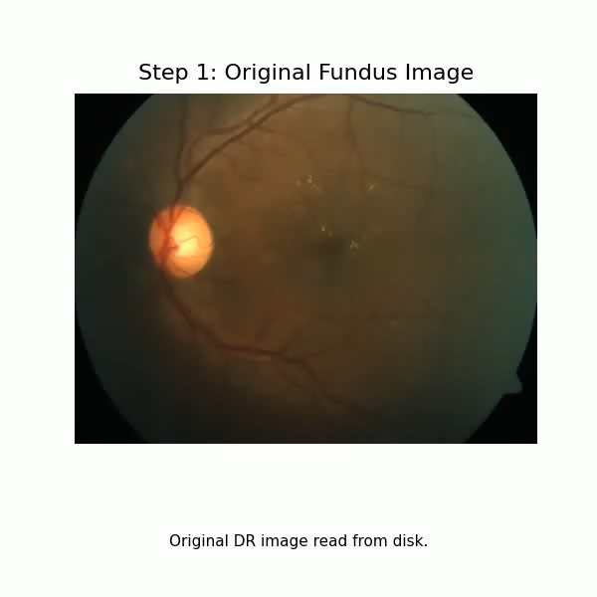
Approach
Accuracy (ACC): Percentage of samples the model classifies correctly.
F1 Score: Balance of precision and recall in a single number.
Kappa (K): Agreement between model and human labels beyond chance.
AUC: Overall ability to separate positive and negative cases across thresholds.

Slide 5
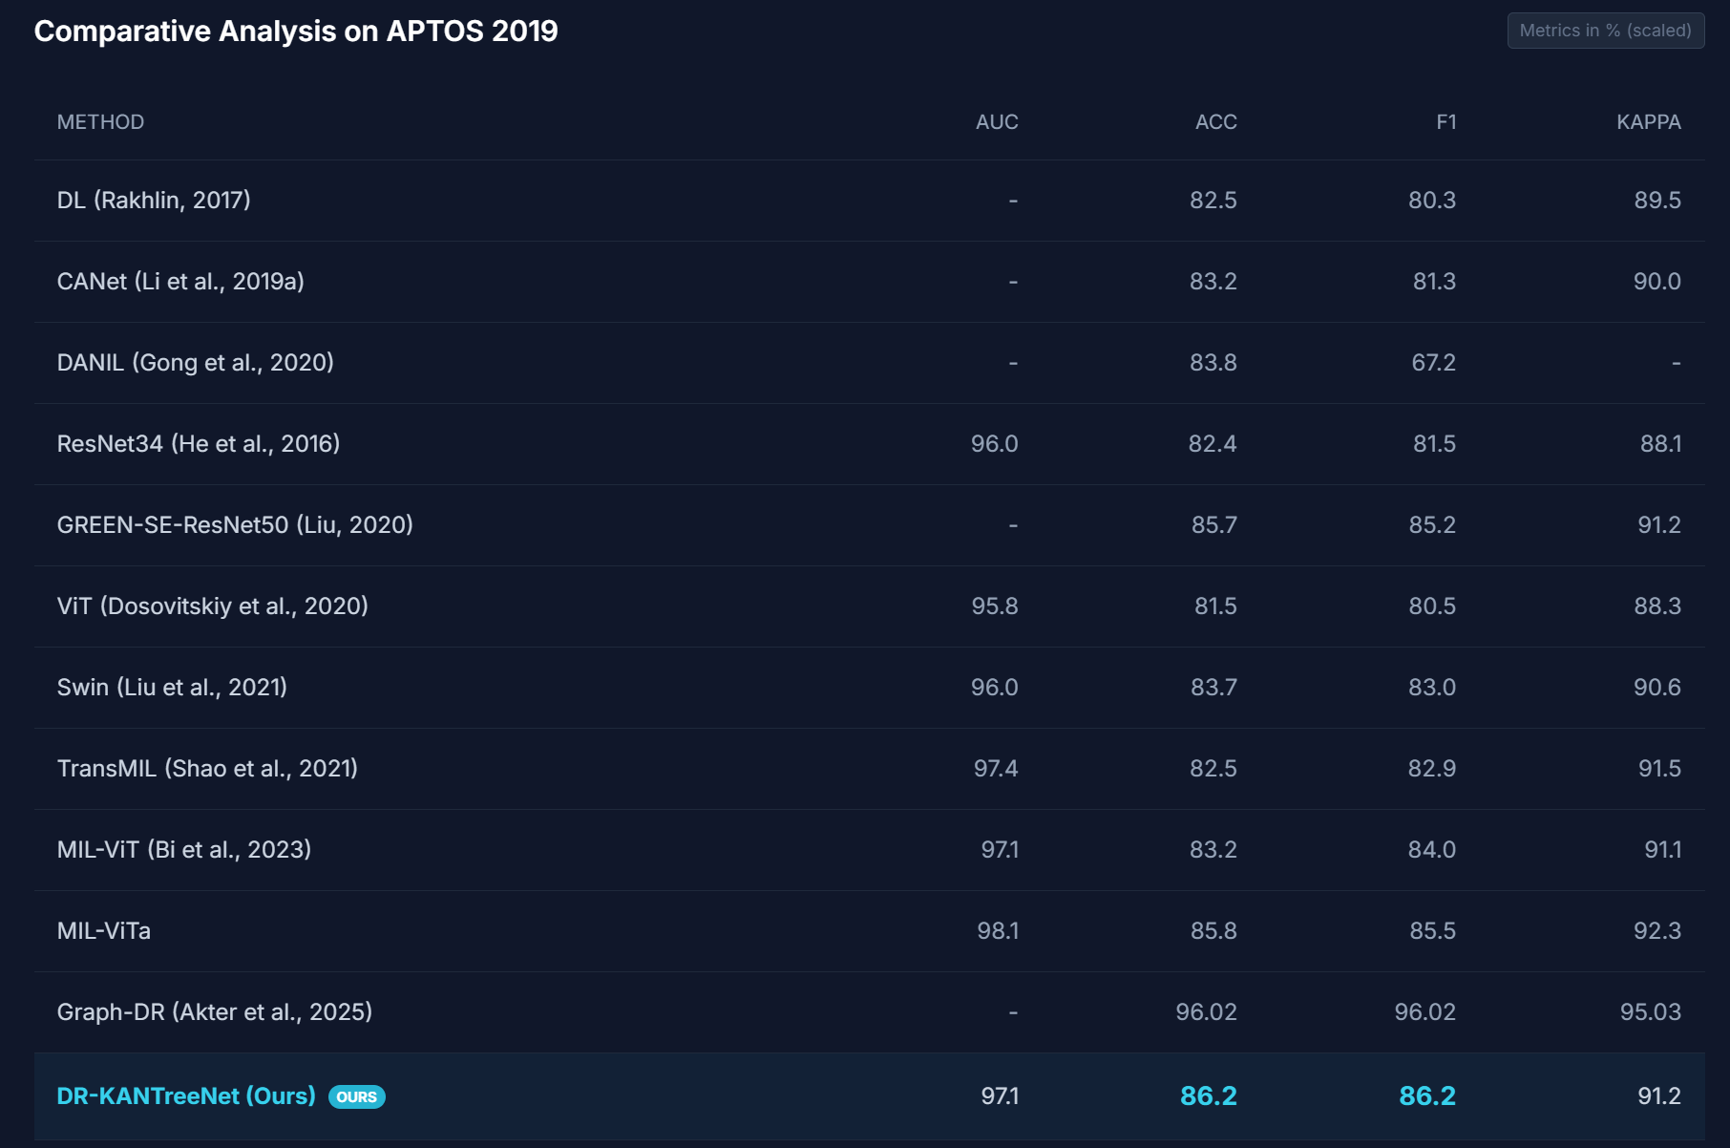
Result

Slide 6
Discussion
In this project, I learned how challenging real-world medical image classification actually is, especially with imbalanced classes and subtle differences between disease stages. Building DR-KANTreeNet forced me to think beyond “just a backbone” and design a model that explicitly uses clinical cues, such as lesion patterns and vessel structure, and then fuse them with KAN to improve both accuracy and interpretability. I also realized how important careful evaluation is: metrics like F1 and Kappa Score tell a much richer story than accuracy alone, especially for screening tasks.

Slide 7
THANK YOU!

